Slide 1
Digital Vision Kista
Stockholms väg till en digital tvilling
(2023-2025)

Slide 2
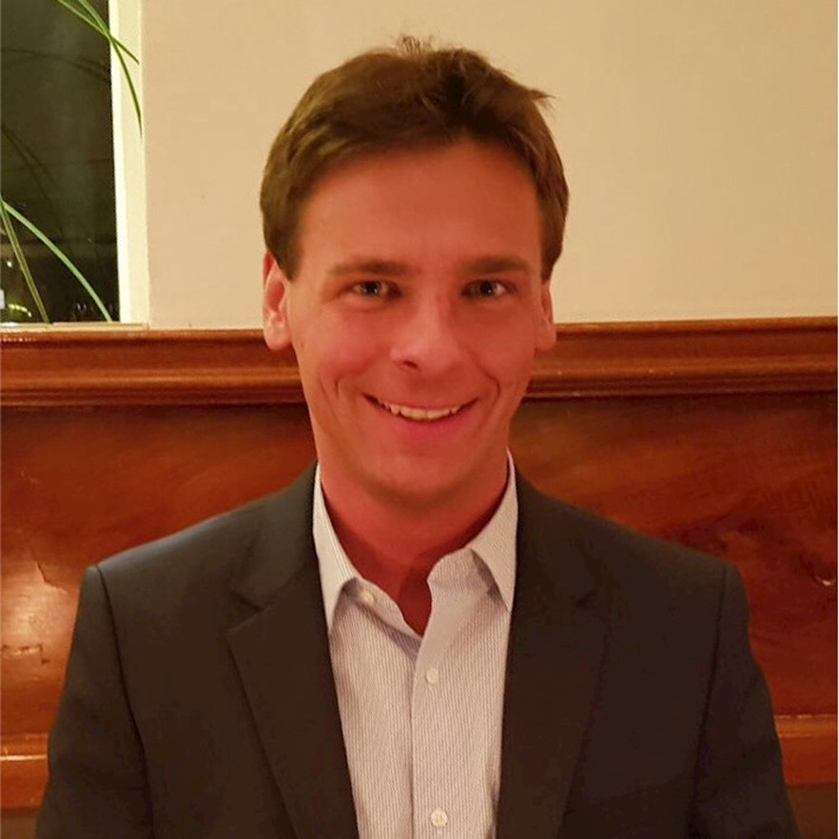





Talare
Selvi Senthamiz
senthamiz.selvi.a@ericsson.com

Slide 3
Dagens resa
Varför
kommunala digitala tvillingar
Metod
för framtagning av
kommunala
digitala tvillingar
37
användarfall
8
mockups
Paus
Prototyp
i praktiken
IoT
i ett praktiskt användarfall
Vision
av en kommunal digital tvilling
Färdplan
för kommunala digitala tvillingar
Punkt
Notes:
Kaffekopp som ryker

Slide 4
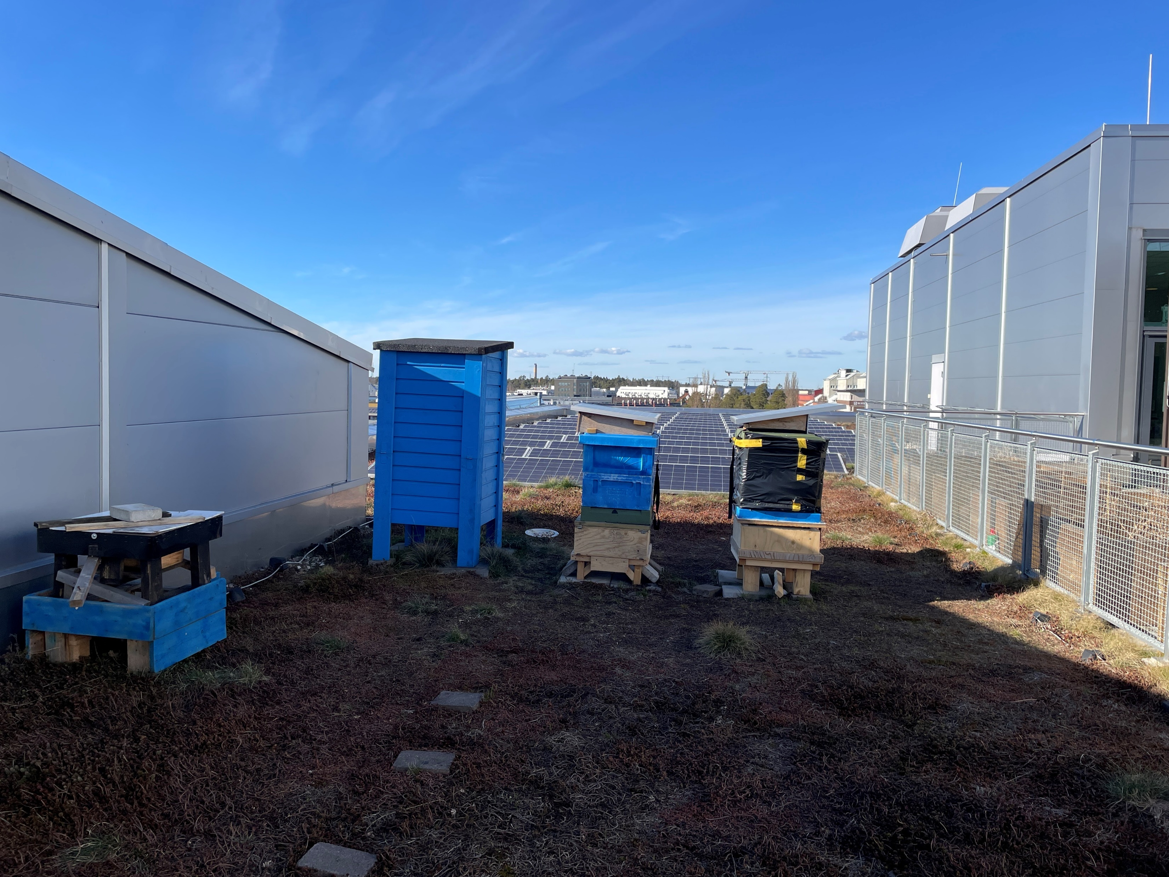
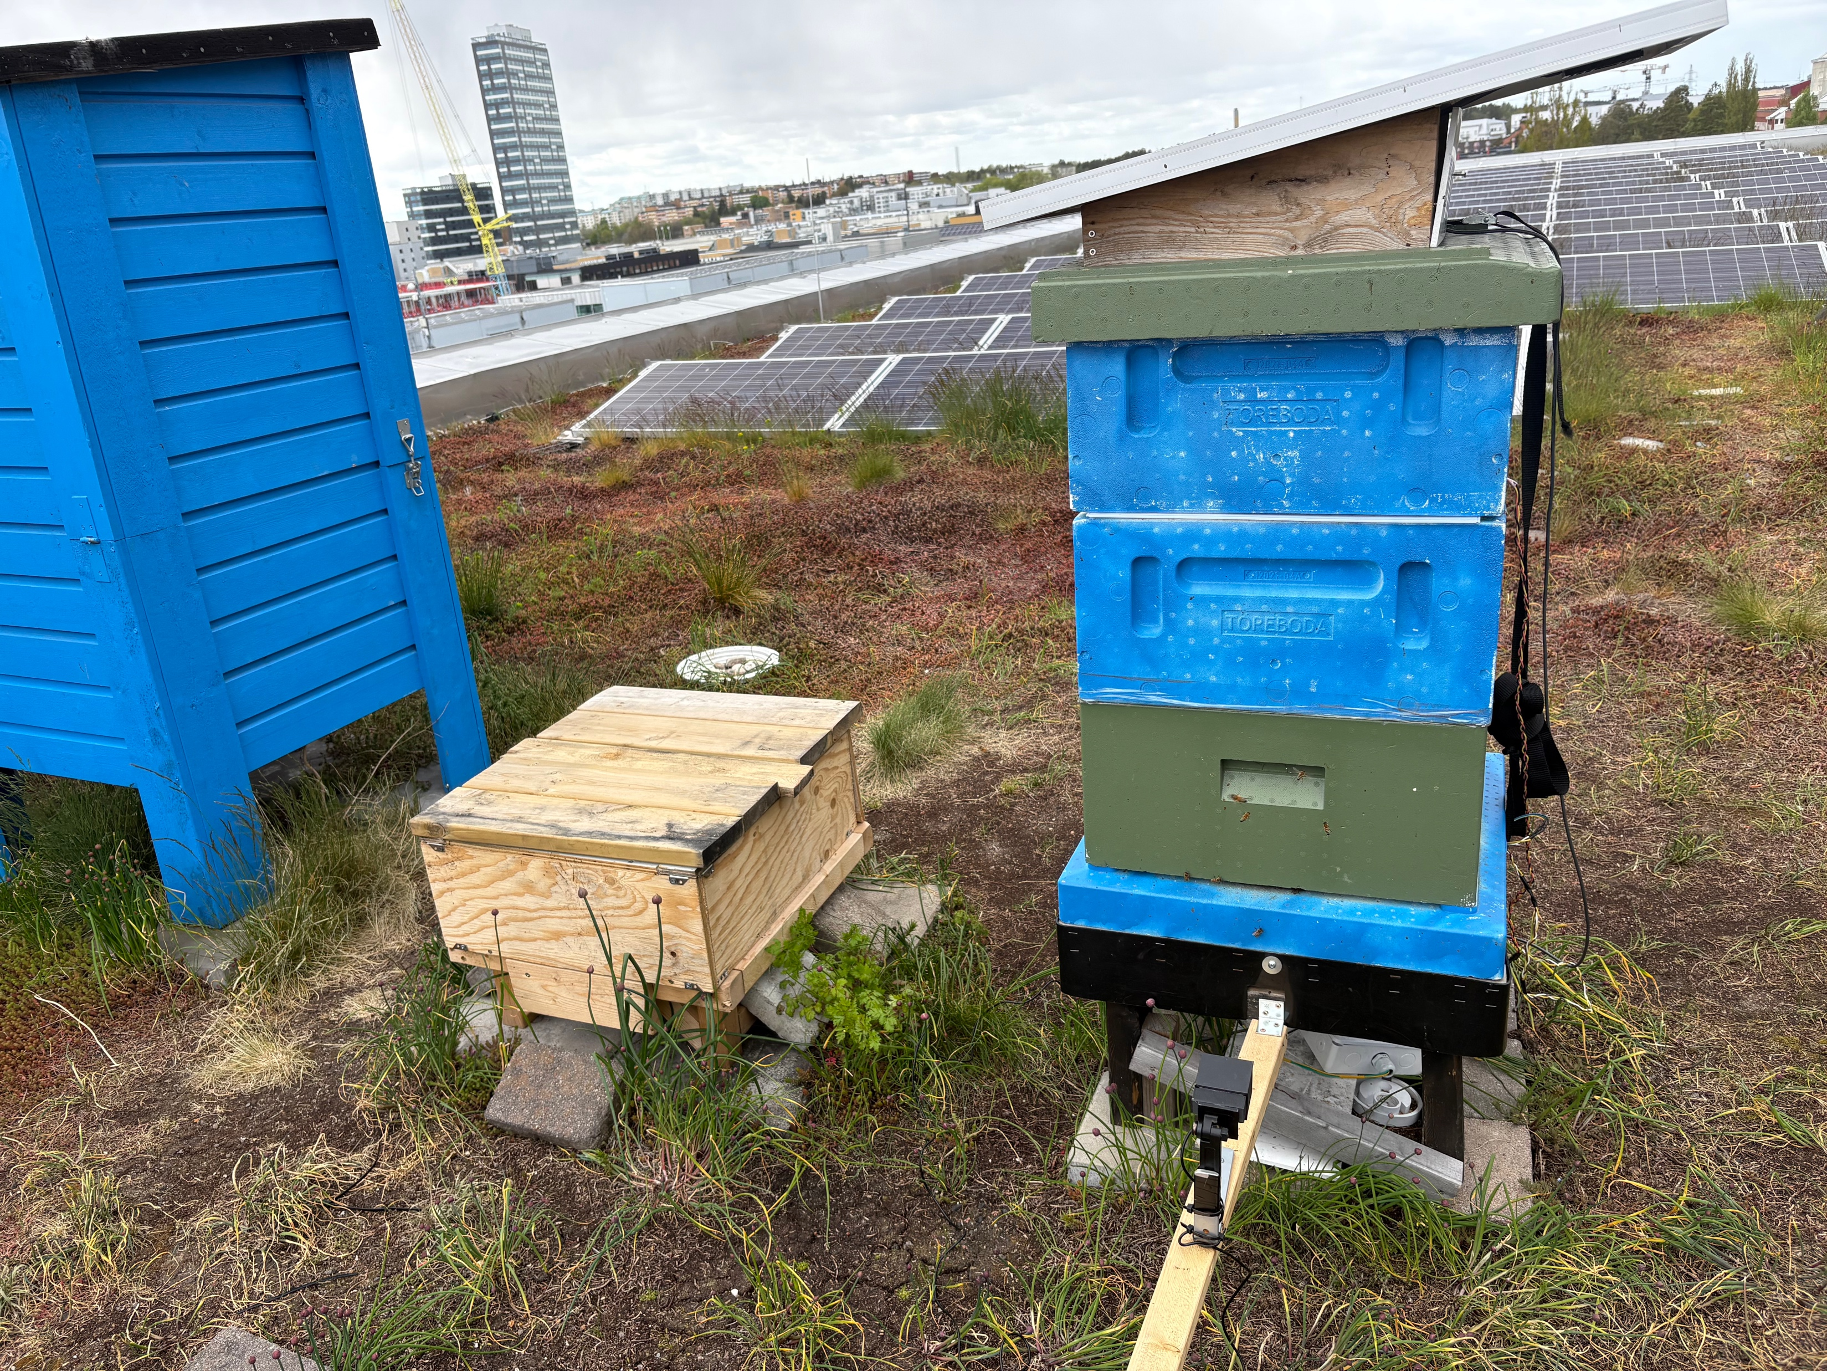
Connected Beehives at Ericsson

Slide 5
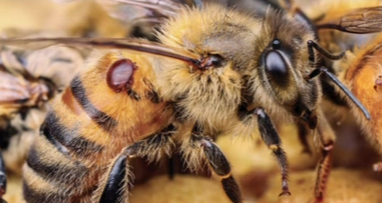
Bees as Biomonitors
Bees, especially honeybees, are effective biomonitors
Foraging over wide areas they and their hive products accumulate trace pollutants, providing integrative, spatially resolved data on environmental contamination
Connected beehive: Create beehive system with bee-colony diagnostic and prescriptive capability
Provides the beekeeper with information about health status for each bee colony
We use a camera at the entrance with AI to detect varroa mites and pollen
Smart Beehive Monitors
Hive environment – Temperature, Humidity
Weather – Rain, Wind, Pressure
Weight
Sound
Video

Slide 6
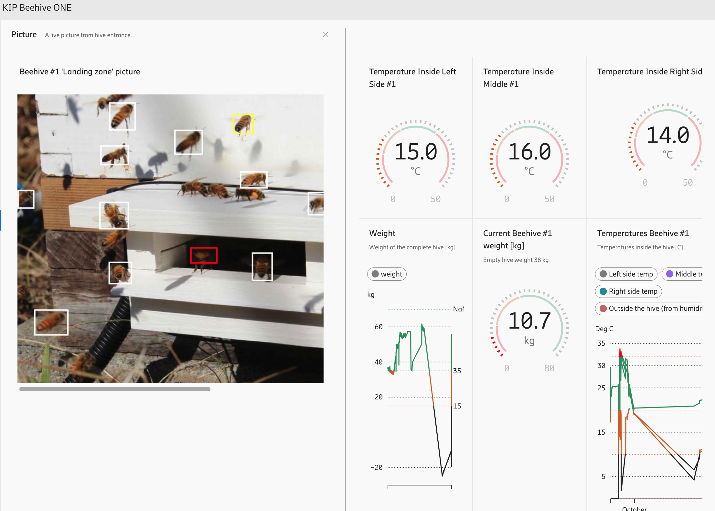

Slide 7
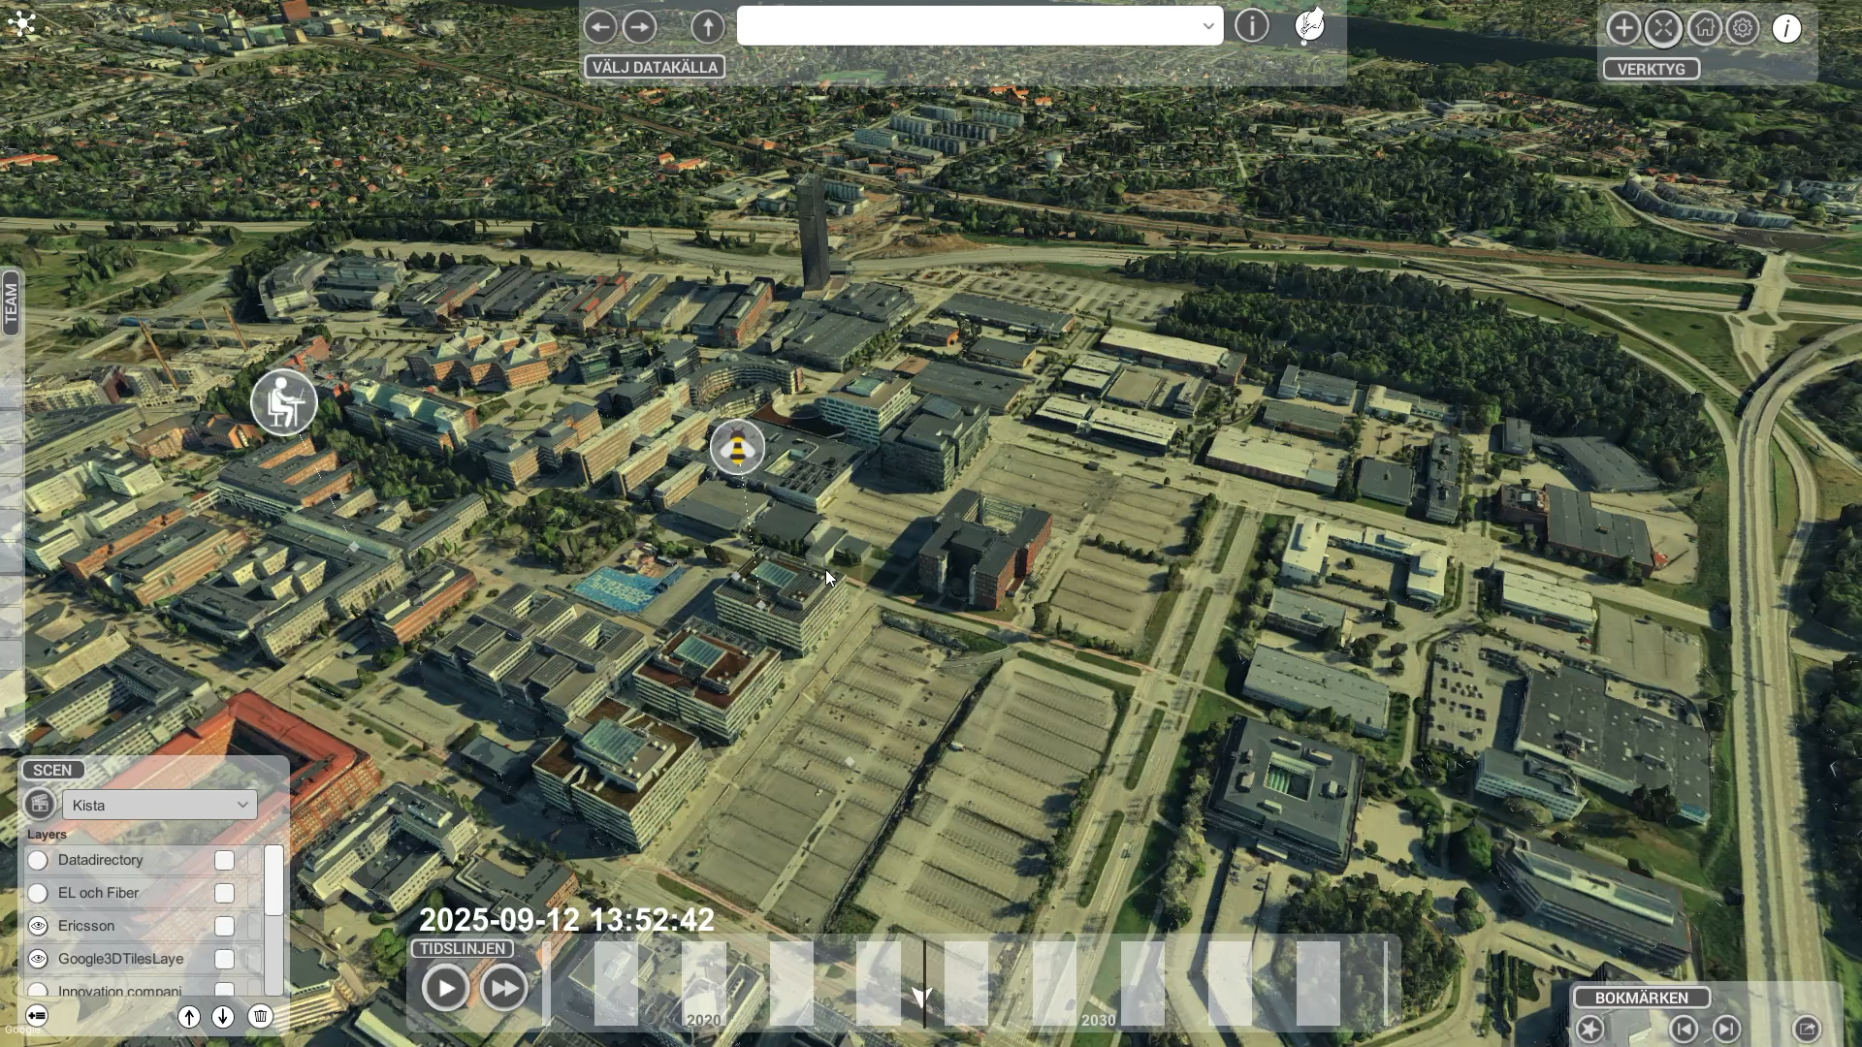

Slide 8
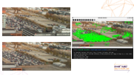
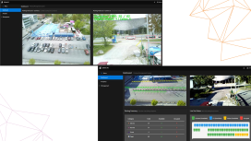
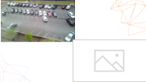
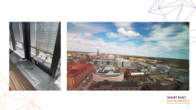
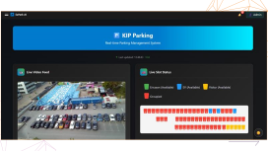
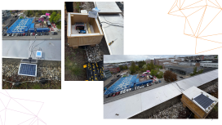
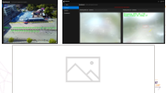
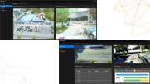
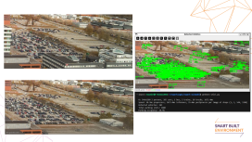
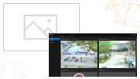
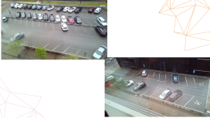
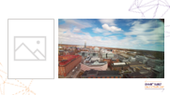
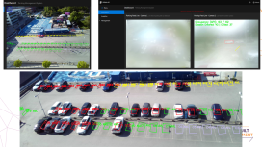
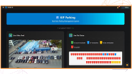
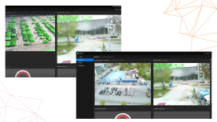
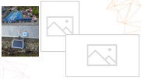
From Cameras to Insights: Applying IoT and AI to Parking
Beginning
Early Exploration
First Prototype
1
2
3
Creative Setup
4
The Challenge
Result
5
6
7
8
Internal Impact
What's Next
Notes:
We installed cameras on the Kista Science Tower to monitor the surrounding areas, with a particular focus on understanding parking space utilization after Ericsson’s directive for employees to return to the office three days a week.
Over time, we collected data at various intervals and managed to gather a full week of high-quality observations. The goal was to apply AI for occupancy tracking—but it quickly became clear that this was more difficult than expected. Permissions, building security, and the sheer scale of the parking lot added to the challenge.
As a first step, we shifted focus to the KIP area, placing a camera on nearby containers to track entry and exit counts. While the results were not always reliable, the approach was well received during internal demo sessions. Inspired by the beehive on the terrace, we borrowed its connection and powered our Raspberry Pi with a solar battery, which gave us a more stable setup and better camera angles.
Applying AI produced mixed results at first—foggy lenses, unreliable detection, and inconsistent tracking. By introducing visual markers and refining the model, we eventually built a stable AI solution that tracked occupancy with good accuracy. Sharing this on Ericsson’s internal social platform generated great feedback and opened the door to further collaboration.
The original motivation was always clear: finding available parking in the large lots is a daily frustration for employees, wasting time as they circle through lanes and upper decks. On top of that, questions around permits—who has them and who doesn’t—have recently emerged, adding another layer to the problem.
For real estate teams, optimizing parking space remains a critical challenge. This project is an important step toward addressing that need.
Slide 1 – Context
“We started by installing cameras on the Kista Science Tower to monitor the surrounding areas. Our main interest was to understand how the parking spaces were being used after Ericsson’s directive for employees to return to the office three days a week.”
Slide 2 – Early Exploration
“We collected data at different times and even got a full week of good-quality data. The idea was to apply AI to detect occupancy—but it turned out to be harder than expected. Permissions, building security, and the size of the parking lot made things cumbersome.”
Slide 3 – First Prototype
“So we began small. We focused on the KIP area and mounted a camera on containers to track entry and exit counts. The results weren’t always reliable, but the concept was well received in our internal demo events.”
Slide 4 – Creative Setup
“Then came a fun twist. Remember the beehive on the terrace? We borrowed its connection and powered our Raspberry Pi with a solar battery. With this setup, we finally got a decent shot of the parking area.”
Slide 5 – AI Challenges
“We applied AI again—still not reliable all the time. Foggy lenses, detection errors, you name it. By adding markers and refining the model, we eventually built a stable solution that tracked occupancy well.”
Slide 6 – Internal Impact
“We published the results on our internal social platform, and the response was amazing. We received lots of feedback and new collaboration opportunities emerged.”
Slide 7 – The Bigger Problem
“But let’s not forget the real pain point. Employees waste time every day circling around, checking lanes, moving to upper decks, only to find no space. And on top of that, we now face questions around parking permits—who has them, and who doesn’t.”
Slide 8 – Why This Matters
“For real estate teams, optimizing parking is critical. This project shows there’s real potential in combining data, AI, and creativity to solve one of the everyday problems that impacts productivity and employee experience.”

Slide 9
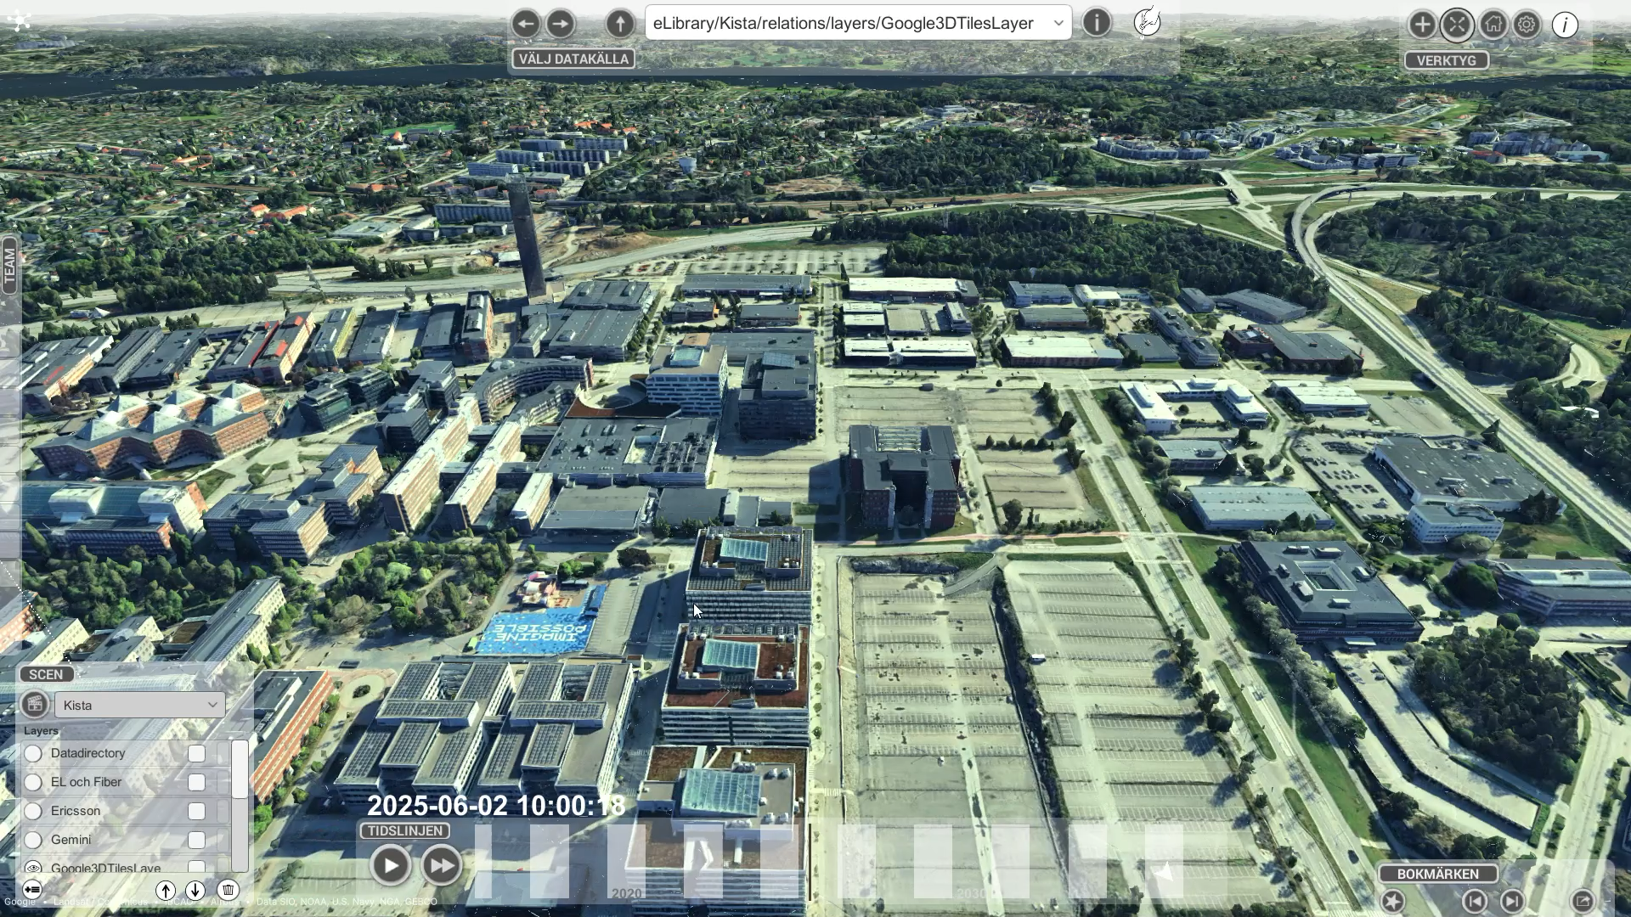

Slide 10
Benefits of using AI and IoT for Parking Management
Real-time visibility & automation for municipalities, airports, campuses, and operators
Municipalities: Monitor loading zones, bike lanes, and short-term parking activity
Operators: Automate compliance checks and payment processes
Safety & enforcement: Evidence-based data supports insurance claims
IoT sensors: Provide accurate, real-time occupancy data
Urban planners & administrators: Reduce congestion, improve air quality, and support sustainable city living
Integrated networks: Connect parking data with mobility, enforcement, and planning platforms
City-wide impact: Enable strategies for congestion reduction and optimized resource use

